Slide 1
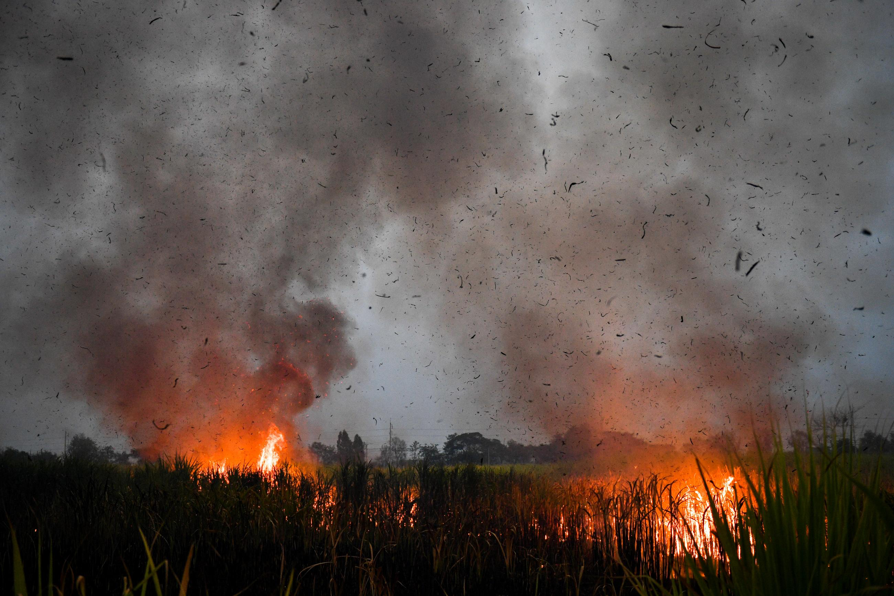
Short-term PM2.5 Forecasting using Geospatial Data
A CS191W project by Nachat Jatusripitak
Advised by Dan Iancu and Mykel Kochenderfer
June 2, 2025
REUTERS/Chalinee Thirasupa

Slide 2
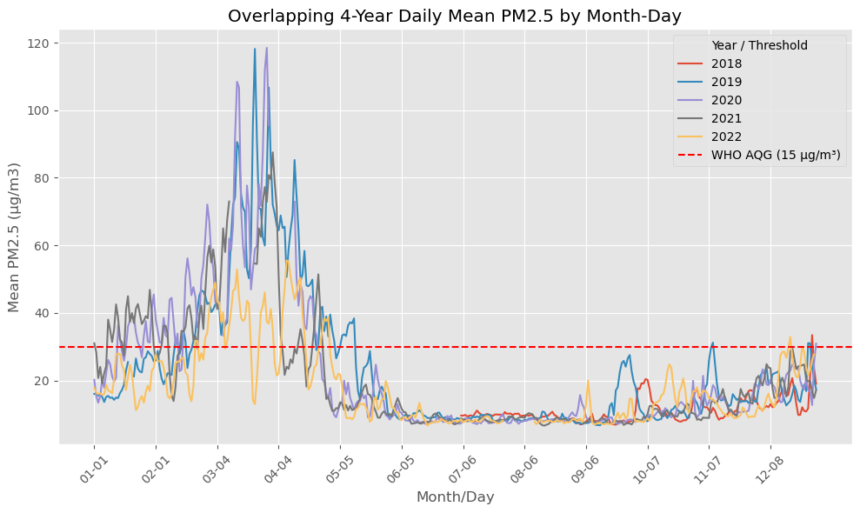
PM2.5 is a public health threat to Southeast Asia

Slide 3
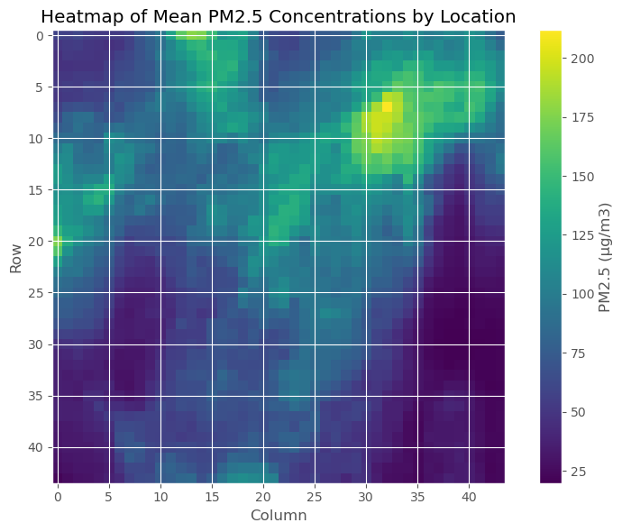

Accurate, scalable forecasting $→$ targeted interventions
With high-frequency regional forecasting, policymakers can strategically:
Issue timely warnings for vulnerable populations
Impose targeted and temporary restrictions on high-emissions activities
Deploy emergency services to high-risk communities

Slide 4
Lack of born-spatial gridded datasets for PM2.5 forecasting

Slide 5
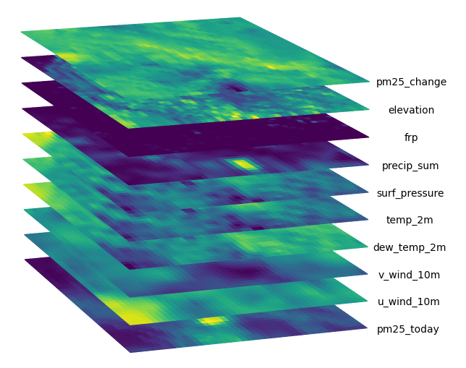
Dataset from satellite retrieval and reanalysis
Data | Source
PM2.5 | GHAP
Elevation | SRTM v4
Climate | ERA5-Land
Active Fire | VIIRS VNP14IMG
44 x 44px GeoTIFF images gridded at ~11.1km spatial res., daily temporal res.

Slide 6
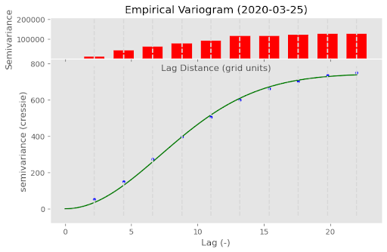
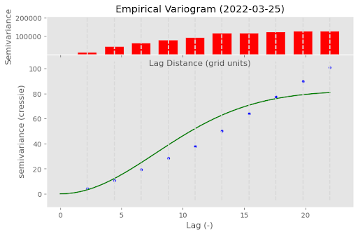

Slide 7
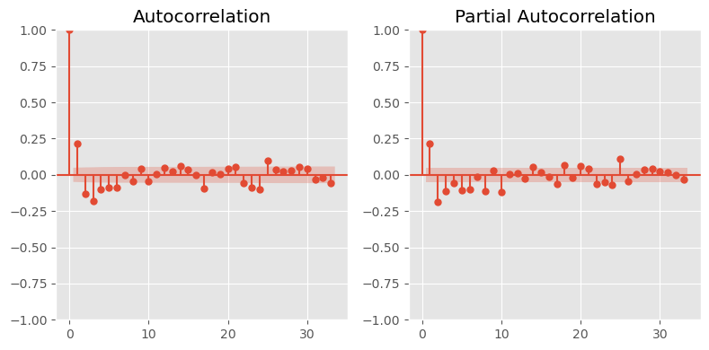

$Δ\text{PM}\text{2.5}$shows spatiotemporal autocorrelation
ACF/PACFs detect temporal autocorrelation up to 20-ish days
Suggests purging gap of ~20 days is needed to avoid temporal leakage

Slide 8
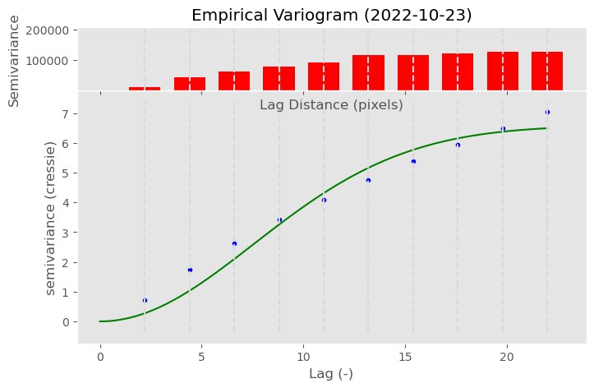

$Δ\text{PM}\text{2.5}$ exhibits spatial autocorrelation
Variograms detect spatial autocorrelation (beyond 20 pixels on some days)
Suggests image pixels must be treated together to avoid spatial leakage

Slide 9

Spatiotemporal CV informed by autocorrelation
Test
Window 10
$$⋮$$
Train: 2 years
Window 3
Val: 7 weeks
Test: 1 year
Window 2
Gap: 3 weeks
Window 1
Time

Slide 10
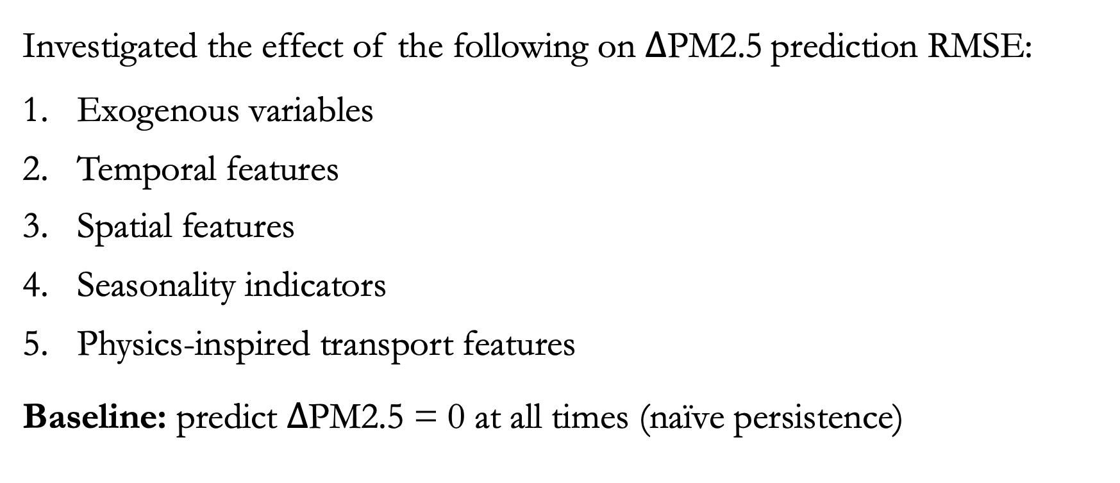
Trained XGBoost on tabularized dataset
Investigated the effect of the following on $Δ\text{PM}\text{2.5}$prediction RMSE:
Exogenous variables
Temporal features
Spatial features
Seasonality indicators
Physics-inspired transport features
Baseline: predict $Δ\text{PM}\text{2.5 = 0}$ at all times (naïve persistence)

Slide 11
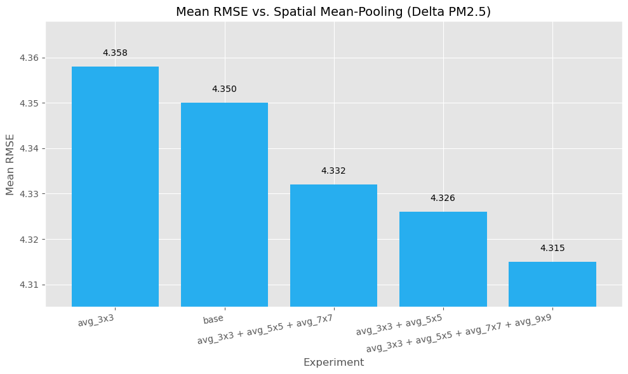
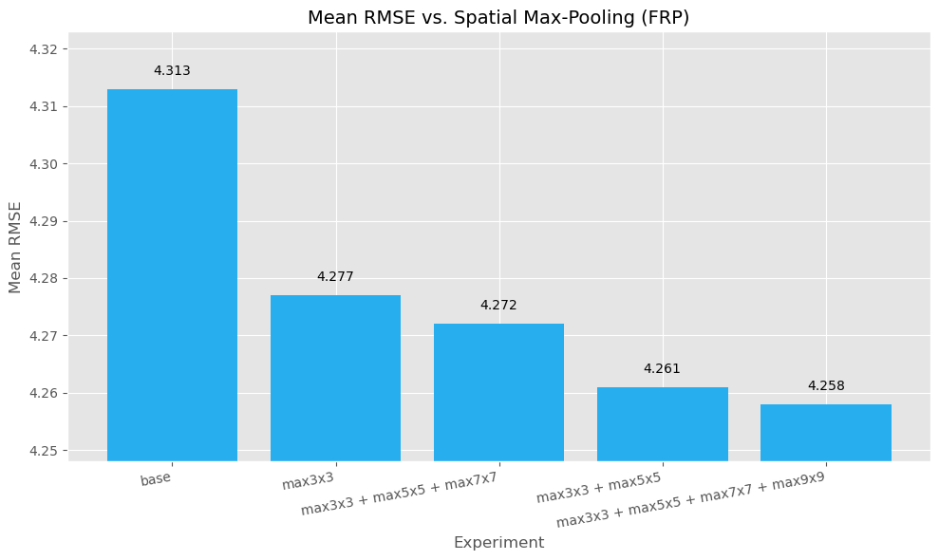
More spatial context improves RMSE
(left: mean-pooling $Δ\text{PM}\text{2.5}$, right: max-pooling FRP)

Slide 12
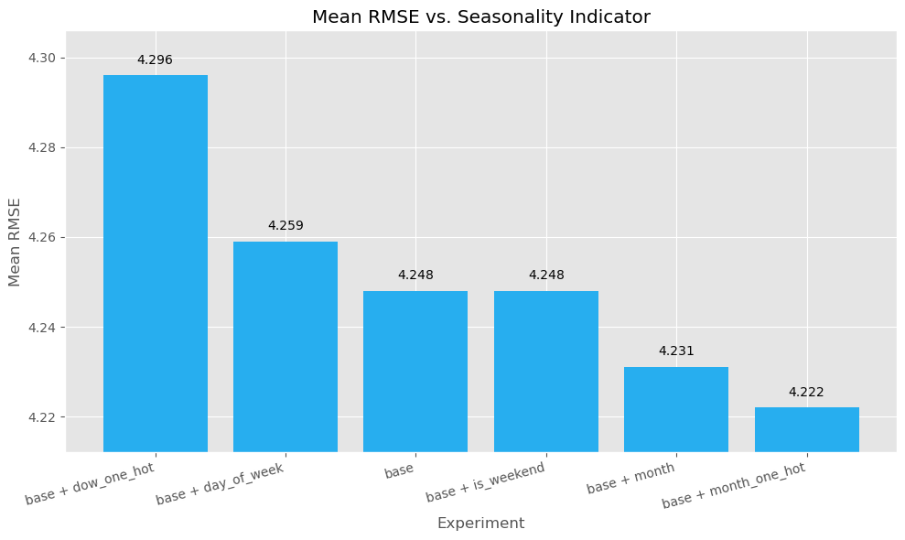
Monthly indicators provide modest benefit
Monthly indicators tell the model if we are in a high-pollution season

Slide 13
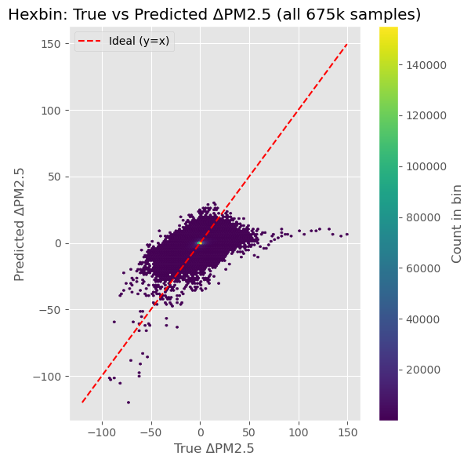
10% lower RMSE than baseline on test set
Model (RMSE: 5.05) showed superior performance to naïve baseline (RMSE: 5.62) on 2022 test set.
Observations:
Reasonable performance on ‘regular’ days.
Fails to capture extreme pollution events.
Slight negative bias – underpredicts changes.

Slide 14
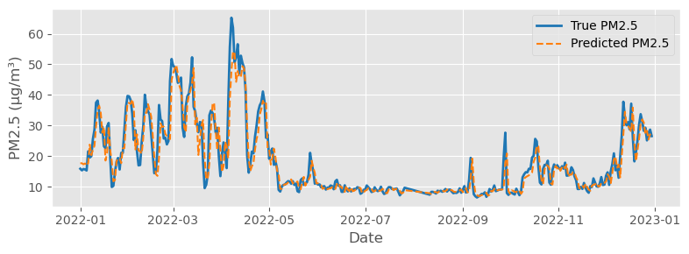
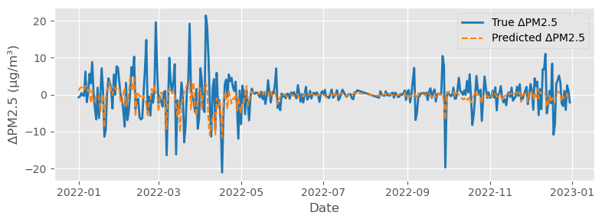
Emissions modeling needs improvement

Slide 15
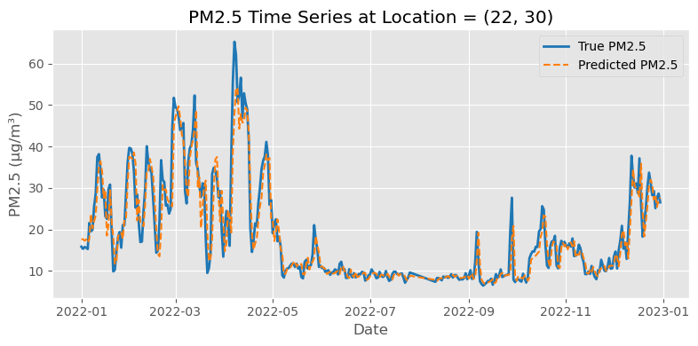
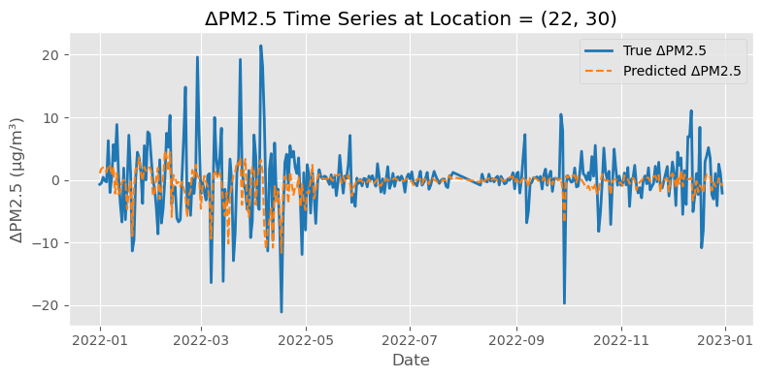

Slide 16
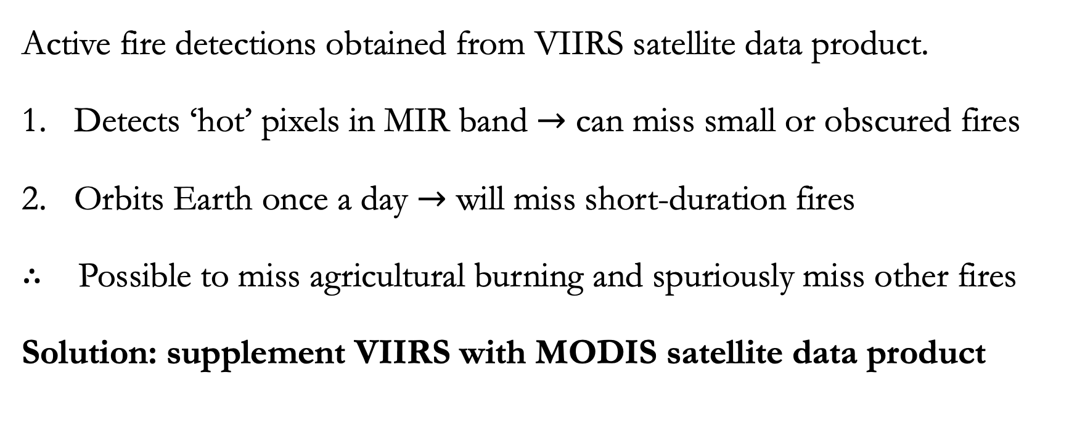
Active fire data can miss small and short fires
Active fire detections obtained from VIIRS satellite data product.
Detects ‘hot’ pixels in MIR band $→$ can miss small or obscured fires
Orbits Earth once a day $→$ will miss short-duration fires
$∴$ Possible to miss agricultural burning and spuriously miss other fires
Solution: supplement VIIRS with MODIS satellite data product

Slide 17
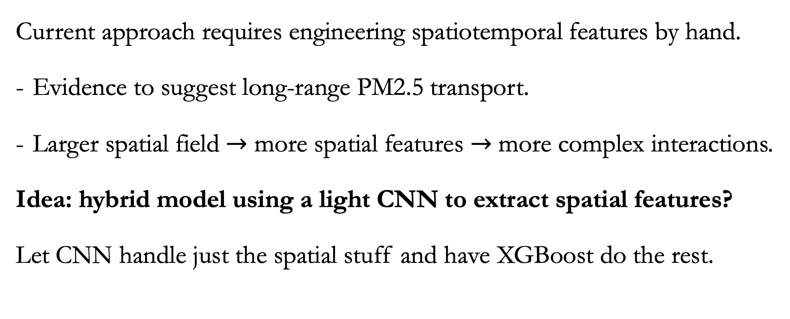
XGBoost is not an inherently spatiotemporal model
Current approach requires engineering spatiotemporal features by hand.
Evidence to suggest long-range PM2.5 transport.
Larger spatial field $→$ more spatial features $→$ more complex interactions.
Idea: hybrid model using a light CNN to extract spatial features?
Let CNN handle just the spatial stuff and have XGBoost do the rest.

Slide 18
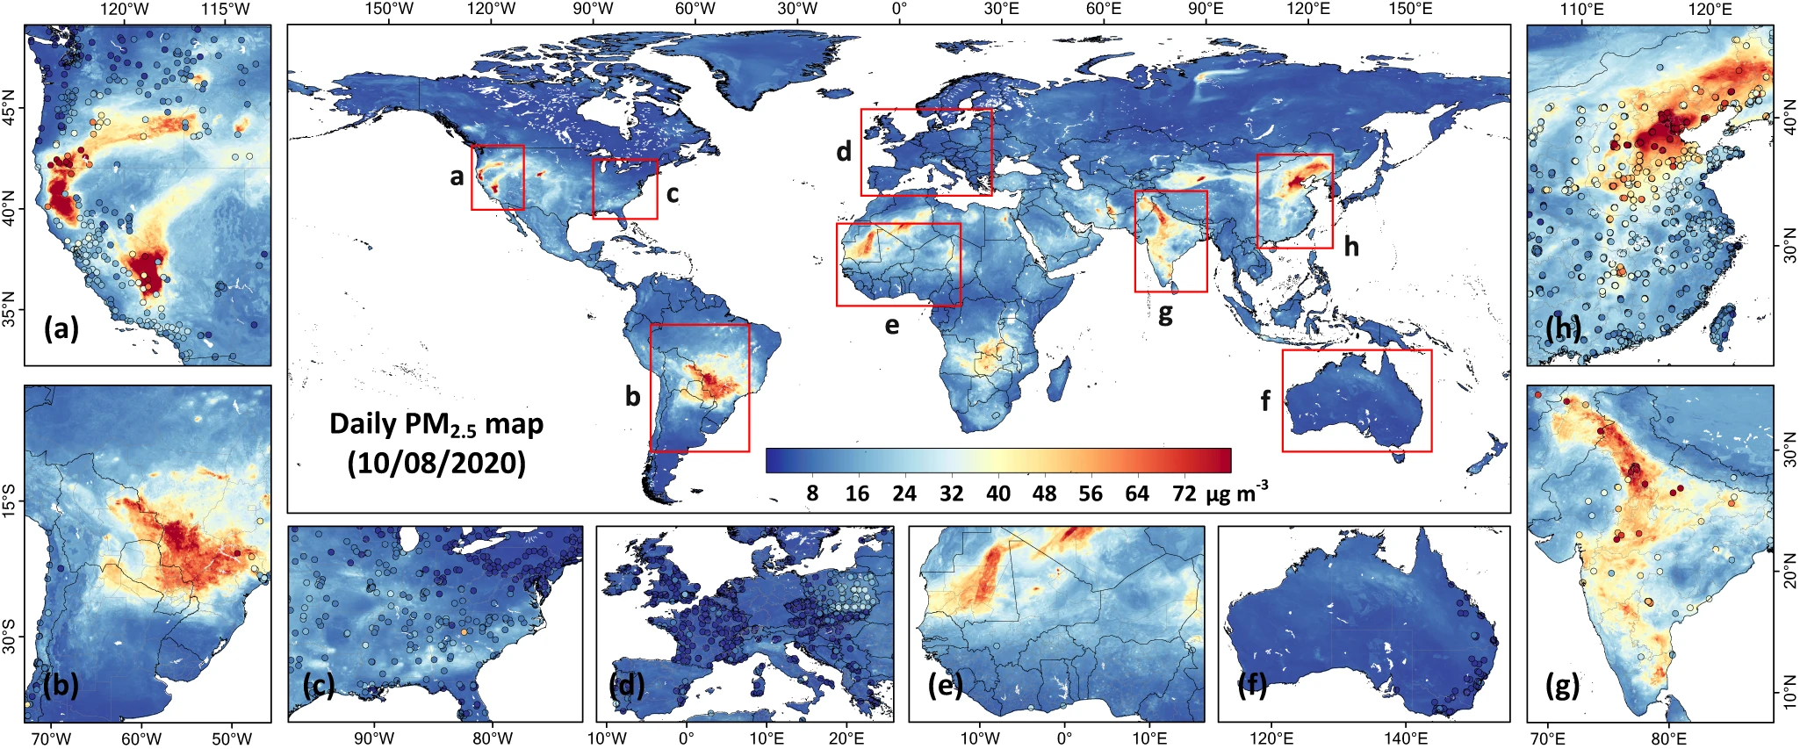
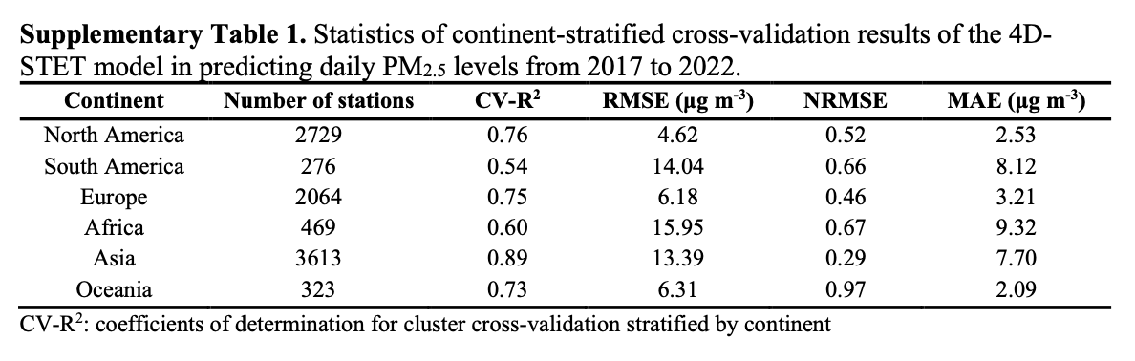
PM2.5 data is only a synthetic “ground truth”
Why do we use it?
Gapless (no missing data)
High spatiotemporal resolution
What’s wrong with it?
RMSE of ~13.39 μg/m3 in Asia
Not validated in remote regions
Image and table courtesy of Wei et al. (2023)

Slide 19
Conclusion
Short-term PM2.5 forecasting is important for targeted policymaking.
Constructed a born-spatial gridded dataset for training such models.
Experiments with XGBoost found issues with extreme values and spatiotemporal autocorrelation.
Future work should address these limitations in the data and model.

